Slide 1
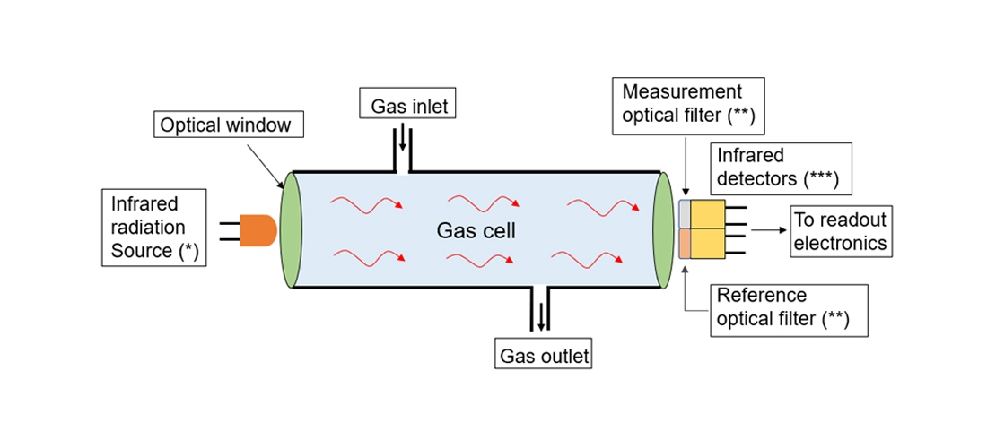
NDIR Gas Sensor
Presented by:
Rishav Pandey
Under the guidance of
Dr. Vijay Chatterjee, Scientist, CSIR-CEERI

Slide 2
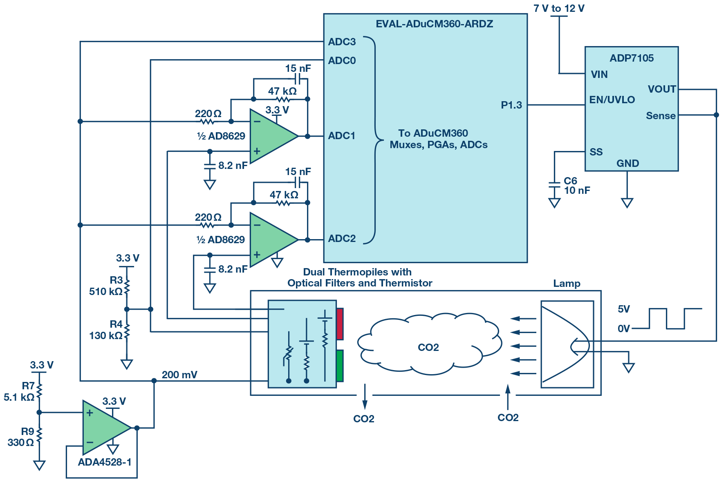
NDIR Gas Sensor Using Thermopile Detector

Slide 3
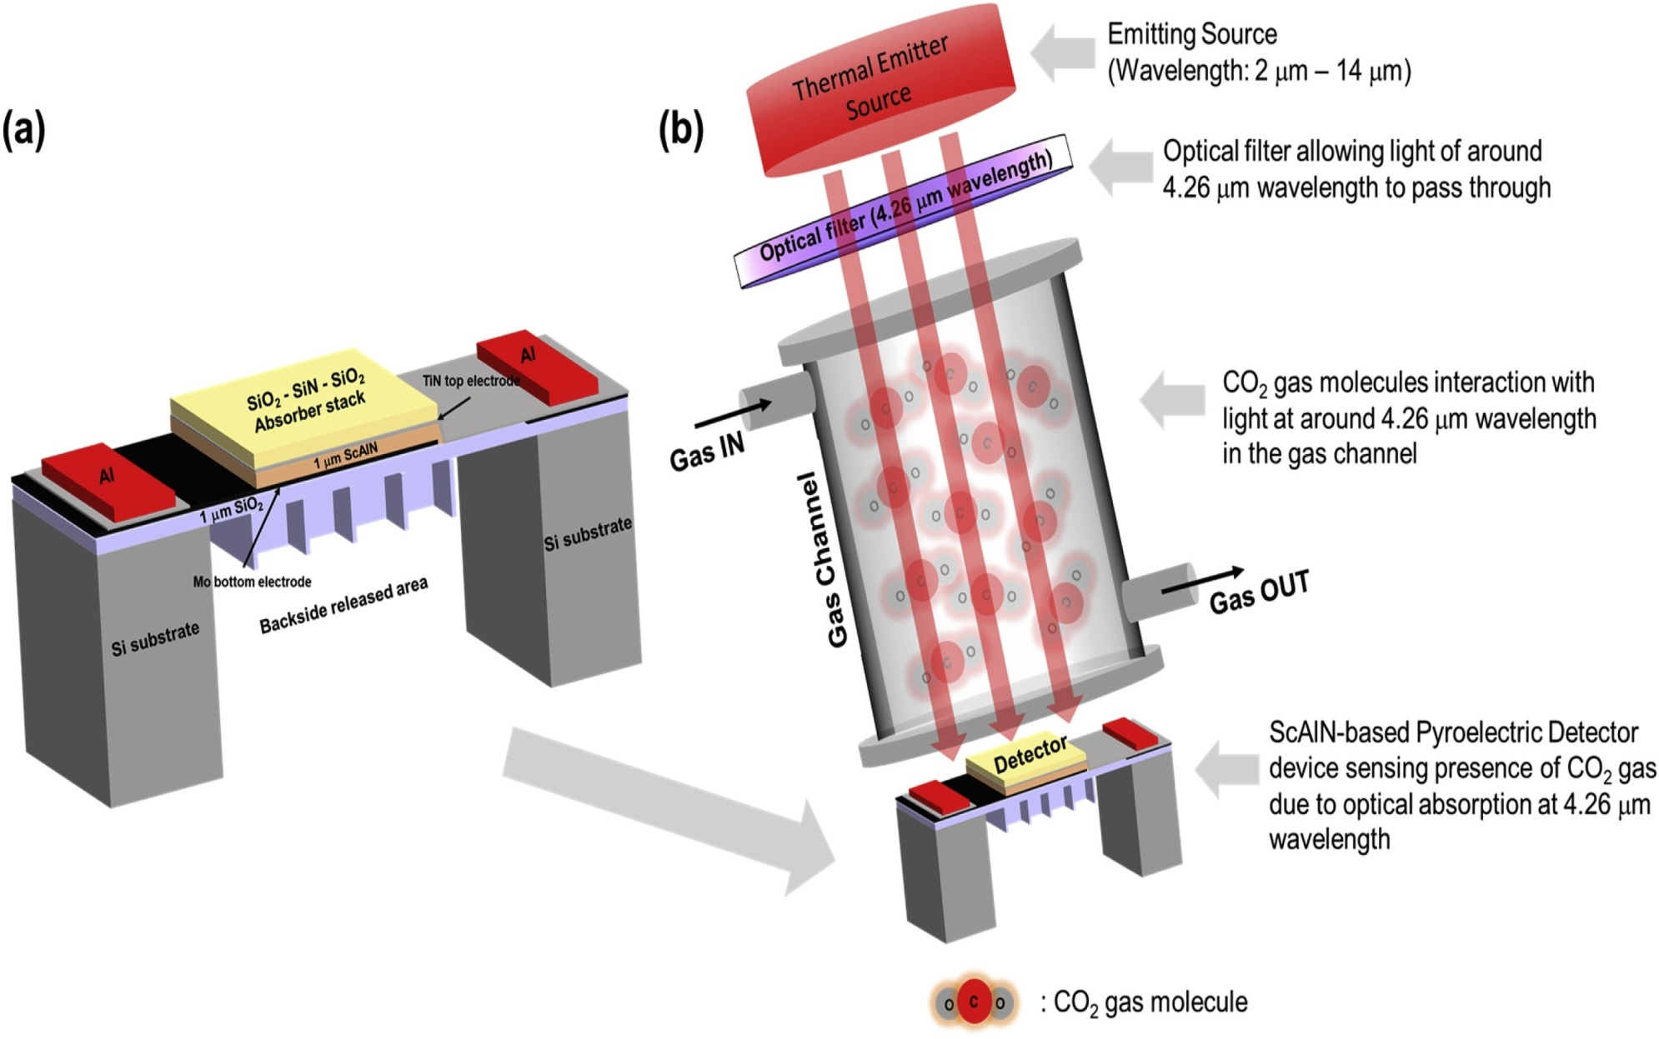
NDIR Gas Sensor Using Pyroelectric Detector

Slide 4
Optical Window & Optical Filters
Since there are different ways to detect an infrared radiation, i.e. an IR light in basic NDIR System can be detected by various detectors like bolometer, thermistor, thermocouples, and pyroelectric detector. So, we have different architecture in each of the aforementioned detection methods.
We found that if we are using an optical window to filter the infrared light (of wavelength 0.7 μm to 1 mm) to a particular wavelength of around 4.26 μm then we shall not use active and reference filter near the detector side.
However, if there is no optical window, then IR light of all possible wavelengths will pass through the gas cylinder. Some of the IR radiation will be absorbed by CO₂ gas molecules while other will be passed unabsorbed. In this case it’s important to use active and reference filter to calculate the overall decrease in IR radiation.

Slide 5
Cont….
Infrared light that is absorbed by CO₂ gas molecules passes through the active filter with a particular wavelength. Infrared light that does not interact with CO₂ gas molecules passes through the reference filter. The difference between transmitted light intensities is converted into gas concentration.

Slide 6
Ideal Length Of NDIR Gas Cylinder
The most ideal dimension of gas chamber as per industry standard is a cylinder with 20mm Diameter x 16.5mm Length.
With this length of cylinder there is a negligible decrease in the intensity of IR radiation.
Since, as we increase the length of the gas chamber intensity of IR radiation decreases exponentially as per the below mentioned Lambert Law.
I=I₀ e^{-kl} or, A ∝ l

Slide 7
How to prevent loss of intensity due to multiple reflection?
In NDIR Gas Sensor, the intensity of IR radiation also decreases because of continuous reflection within the gas chamber.
So, in order to prevent this decrease in intensity, the gas chamber is coated with a layer of gold, so as to absorb minimum IR radiation.

Slide 8
References….
https://www.co2meter.com/
https://en.gassensor.com.cn/
https://www.analog.com/
https://www.researchgate.net/

Slide 9


